Slide 1

OOP
Opentechz Pvt Ltd .
By Parthasarathi Swain

Slide 2

What is OOP? (OOP = Object-Oriented Programming)
Definition : OOP is a programming style where everything is represented as an object.
What is an object? An object is a real-world entity (like a car, student, or bank account) that has:
Why OOP?
Helps organize code around real-life things
Makes code modular – each class handles a specific part
Makes code reusable – write once, use again
Makes code maintainable – easier to debug and update
Popular OOP Languages:
C++ ,Java ,Python

Slide 3
Features of Object-Oriented Programming (OOP)
Class
Object
Encapsulation
Abstraction
Inheritance
Polymorphism

Slide 4

What is class ?
A class is a user defined data type or blue print or specification or logical constructor of an object.
A class is user defined of an object because using class we can store multiple object.
A class is called blue print of an object because using class we can create multiple objects of same type.
A class is called specification of an object because it specify what an object contains.
A class is also called logical constructor of an object because it constructs object logically(design) an object.

Slide 5
What is an Object ?
A object is real world things which is an instance of a class .
State: represent data of an object.
Behaviour: represent the behaviour (functionality) of an object such as deposit, withdraw, sleep, fooding....etc
Identity: An object indentity is typically implemented a via unique ID.

Slide 6

#include <iostream>
using namespace std;
class Dog {
public:
string name;
string breed;
int age;
void sleep() {
cout << name << " is sleeping." << endl;
}
};
int main() {
Dog dog1;
dog1.name = "Tommy";
dog1.breed = "Labrador";
dog1.age = 3;
dog1.sleep();
return 0;
}
class object relation

Slide 7
Members of a Class
Data Members (Variables / Attributes)
Member Functions (Methods)
Access Specifiers (public, private, protected)
Constructors
Destructors
Static Members

Slide 8
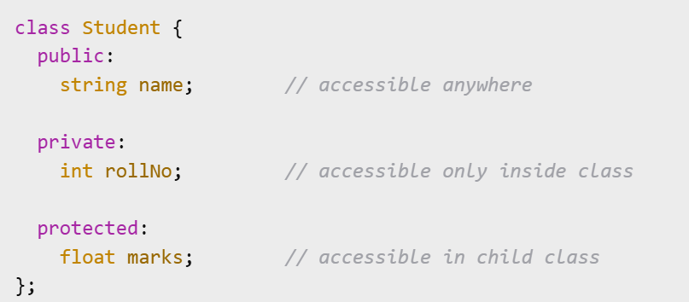
Access Specifiers in C++
Access specifiers control who can access class members (variables and functions).
public
Members are accessible from anywhere in the program.
private
Members are accessible only inside the class.
Not accessible from outside or from derived classes.
protected
Members are accessible inside the class and in derived (child) classes.
Not accessible from outside the class.

Slide 9
What is a Constructor?
A constructor is a special function in a class.
It is automatically called when an object is created.
It is used to initialize object data.
A constructor has the same name as the class and no return type.
Types of Constructors in C++
1. Default Constructor
Takes no parameters.
Provides default values to object data.
2.Parameterized Constructor
Takes parameters to assign custom values to object data.
3. Copy Constructor
Creates a new object by copying values from an existing object.

Slide 10
class Student {
public:
string name;
int age;
// Default Constructor
Student() {
cout<<“Default cons”<<endl;
}
// Parameterized Constructor
Student(string n, int a) {
cout<<“Parameterized cons”<<endl;
}
// Copy Constructor
Student(const Student &s) {
cout<<“Parameterized cons”<<endl;
}
};
int main() {
// Calls Default constructor
Student s1;
// Calls Parameterized constructor
Student s2("John", 20);
// Calls Copy constructor
Student s3 = s2;
return 0;
}

Slide 11
Destructor in C++
A destructor is a special function in a class.
It is called automatically when an object goes out of scope or is deleted.
Used to free resources (memory, files, etc.).
Has the same name as the class, but with a tilde (~) before it.
No return type and no parameters.
~ClassName() {
// cleanup code
}

Slide 12
#include <iostream>
using namespace std;
class Student {
public:
Student() {
cout << "Constructor called" << endl;
}
~Student() {
cout << "Destructor called" << endl;
}
};
int main() {
Student s1; // Constructor runs here
// Destructor will run automatically at the end of main
return 0;
}

Slide 13
Static Members in C++
Static members belong to the class rather than any one object.
Static Data Members:
Only one copy exists, shared by all objects.
Declared using the static keyword.
Must be defined outside the class.
Static Member Functions:
Can access only static data members.
Can be called using the class name directly.

Slide 14
#include <iostream>
using namespace std;
class Student {
public:
static int count;
Student() {
count++;
}
static void showCount() {
cout << "Total Students: " << count << endl;
}
};
// Definition of static data member
int Student::count = 0;
int main() {
Student s1, s2, s3;
// Accessing static function
Student::showCount();
return 0;
}

Slide 15
Encapsulation in C++
Encapsulation is the process of binding data and functions that operate on the data into a single unit — the class.
It helps in:
Protecting data from unauthorized access
Achieving data hiding
Making code more modular and secure
Real-Life Example:
Think of a bank account:
You can deposit or withdraw money,
But you can't directly access the balance — it's hidden inside.

Slide 16
#include <iostream>
using namespace std;
class BankAccount {
private:
int balance;
public:
void deposit(int amount) {
if(amount > 0)
balance += amount;
}
int getBalance() {
return balance;
}
};
int main() {
BankAccount acc;
acc.deposit(1000);
cout << "Balance: " << acc.getBalance(); //Output: 1000
return 0;
}

Slide 17
Abstraction in C++
Definition: Abstraction is the process of hiding internal implementation details and showing only the essential features of an object.
Why Use Abstraction?
Reduces complexity
Increases security
Focuses on what an object does instead of how it does it

Slide 18
#include <iostream>
using namespace std;
class BankAccount {
private:
int balance;
public:
BankAccount() {
balance = 1000;
}
void deposit(int amount) {
balance += amount;
}
void showBalance() {
cout << "Current Balance: " << balance << endl;
}
};
int main() {
BankAccount acc;
acc.deposit(500);
acc.showBalance();
return 0;
}

Slide 19

What is Inheritance?
One class inherits features (methods & variables) of another
Promotes code reusability
Helps in building hierarchies
Reused class = Base class / Parent class
New class = Derived class / Child class
Real-life Example: A child inherits properties from parents – name, behavior, etc.

Slide 20
Why Use Inheritance?
Avoids code duplication
Enables code extension
Supports polymorphism
Makes maintenance easier
Encourages modular programming
Syntax of Inheritance
Access Modifiers:
public
protected
private
class Base {
// base class members
};
class Derived : access_modifier Base {
// derived class members
};

Slide 21
Types of Inheritance in C++
Single Inheritance
Multilevel Inheritance
Multiple Inheritance
Hierarchical Inheritance
Hybrid Inheritance

Slide 22
Single Inheritance
One base class, one derived class
Most basic form
Example :
class Animal {
void eat();
};
class Dog : public Animal {
void bark();
};
Animal
(Base)
Dog
(Child)

Slide 23
Multilevel Inheritance
A class is derived from a derived class
Forms a chain of inheritance
Example :
Animal
class Animal {
void eat();
};
class Dog : public Animal {
void bark();
};
class Puppy : public Dog {
void weep();
};
(Base)
Dog
(Base 2)
Puppy
(Child)

Slide 24
Multiple Inheritance
A class inherits from more than one base class
Can lead to ambiguity
(Base1)
(Base 2)
Example :
class A {
void show();
};
class B {
void display();
};
class C : public A, public B {
// inherits from both
};
A
B
C
(Child)

Slide 25
Hierarchical Inheritance
Multiple classes inherit from a single base class
Useful in creating multiple child classes from a common parent
Example :
(Base)
class Animal {
void eat();
};
class Dog : public Animal {};
class Lion: public Animal {};
class Tiger : public Animal {};
Animal
Dog
Lion
Tiger
(Child-1)
(Child-2)
(Child-3)

Slide 26
Hybrid Inheritance
Combines two or more types of inheritance
There is no particular syntax of hybrid inheritance.
(Base)
Example :
A
class A {};
class B : public A {};
class C : public A {};
class D : public B, public C {};
B
C
D

Slide 27
Thank You

